Slide 1

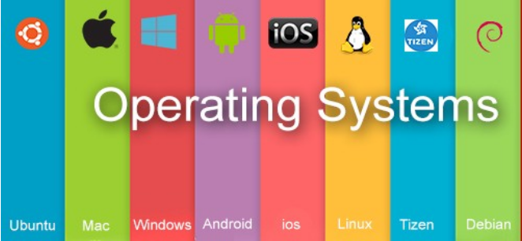
Operating System BCSC0004
Ajitesh Kumar
Assistant Professor
GLAU

Slide 2
Objectives of This Course
To provide basic knowledge of computer operating system structures and functioning including CPU scheduling, memory management, concurrent processes, deadlocks, security, and integrity.

Slide 3
Outcome of this Course
Identify the services provided by operating systems.
Understand the internal structure of an operating system and be able to write programs using system calls.
Understand and solve problems involving process control, mutual exclusion, deadlock and synchronization.

Slide 4
Course Overview
Module | Content | Teaching Hours
I | Introduction: Operating System and its Classification - Batch, Interactive, Multiprogramming, Time sharing, Real Time System, Multiprocessor Systems, Multithreaded Systems, System Protection, System Calls, Reentrant Kernels, Operating System Structure- Layered structure, Monolithic and Microkernel Systems, Operating System Components, Operating System Functions and Services. Processes: Process Concept, Process States, Process State Transition Diagram, Process Control Block (PCB), Process Scheduling Concepts, Threads and their management. CPU Scheduling: Scheduling Concepts, Performance Criteria, Scheduling Algorithms, Multiprocessor Scheduling. Process Synchronization: Principle of Concurrency, Implementation of concurrency through fork/join and parbegin/parend, Inter Process Communication models and Schemes, Producer / Consumer Problem, Critical Section Problem, Dekker’s solution, Peterson’s solution, Semaphores, Synchronization Hardware. Classical Problem in Concurrency: Dining Philosopher Problem, Readers Writers Problem. | 20
II | Deadlock: System model, Deadlock characterization, Prevention, Avoidance and detection, Recovery from deadlock, Combined Approach. Memory Management: Multiprogramming with fixed partitions, Multiprogramming with variable partitions, Paging, Segmentation, Paged segmentation. Virtual memory concepts: Demand paging, Performance of demand paging, Page replacement algorithms, Thrashing, Locality of reference. I/O Management and Disk Scheduling: I/O devices, I/O subsystems, I/O buffering, Disk storage and disk scheduling. File System: File concept, File organization and access mechanism, File directories, File allocation methods, Free space management. | 20

Slide 5
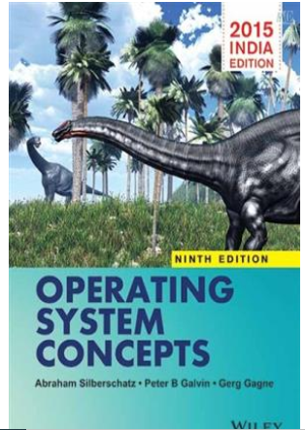
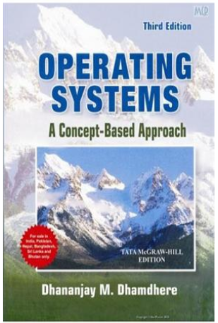
Reference Books
Text Books:
Silberschatz, Galvin and Gagne (2012), “Operating Systems Concepts”,9th Edition, Wiley.
D M Dhamdhere (2006), “Operating Systems: A Concept Based Approach”, 3rd Edition
Reference Books
Harvey M Dietel (2002), “An Introduction to Operating System”, 2nd Edition, Pearson
Education.
M. J. Bach. (1986), “Design of the Unix Operating System”, PHI.

Slide 6
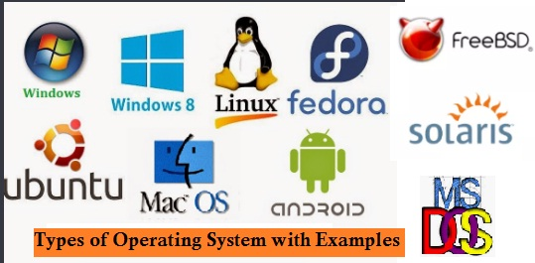
Examples

Slide 7
Assessment & Examination
Total : 100 Marks
CT Component: 80 Marks
Mid Term: 30 Marks
End Term: 50 Marks
TA Component: 20 Marks
Attendance: 05 Marks
Assignment/ Quiz: 15 Marks

Slide 8
Module-I
Introduction: Operating System and its Classification - Batch, Interactive, Multiprogramming, Time sharing, Real Time System, Multiprocessor Systems, Multithreaded Systems, System Protection, System Calls, Reentrant Kernels, Operating System Structure- Layered structure, Monolithic and Microkernel Systems, Operating System Components, Operating System Functions and Services.
Processes: Process Concept, Process States, Process State Transition Diagram, Process Control Block (PCB), Process Scheduling Concepts, Threads and their management.
CPU Scheduling: Scheduling Concepts, Performance Criteria, Scheduling Algorithms, Multiprocessor Scheduling.
Process Synchronization: Principle of Concurrency, Implementation of concurrency through fork/join and parbegin/parend, Inter Process Communication models and Schemes, Producer / Consumer Problem, Critical Section Problem, Dekker’s solution, Peterson’s solution, Semaphores, Synchronization Hardware.
Classical Problem in Concurrency: Dining Philosopher Problem, Readers Writers Problem.

Slide 9
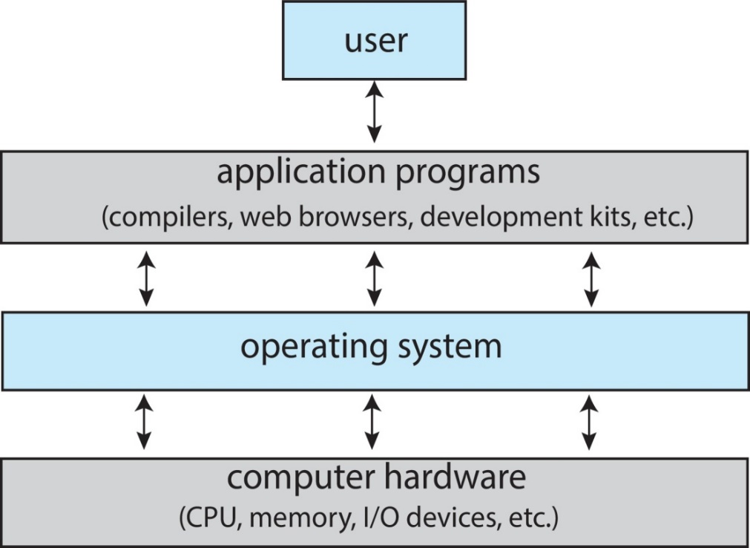
It is a system software
OS is an interface between user and hardware.
Resource Allocator
Manager:
Memory
Process
Files
Security etc.
Goal:
Primary Convenience
Secondary Efficiency
Example: Windows(Microsoft)
macOS (Macintosh), used for Apple’s personal computers and workstations (MacBook, iMac).
iOS (Apple’s OS for iPhone, iPad, and iPod Touch)
Android (Google’s Operating System for smartphones/tablets/smartwatches)
Linux/Ubuntu(open source)
An operating system acts as an intermediary between the user of a computer and computer hardware. The purpose of an operating system is to provide an environment in which a user can execute programs conveniently and efficiently.

Slide 10
What is operating system?
a) collection of programs that manages hardware resources
b) system service provider to the application programs
c) link to interface the hardware and application programs
d) all of the mentioned
• Operating system is a collection of
a) Software routine
b) Input-output device
c) Hardware components
d) All of these
Which one is correct hierarchy of memory according to speed and cost?
a) Magnetic tape, magnetic disk, cache, main memory, registers
b) Magnetic disk, magnetic tape, cache, main memory, registers
c) Magnetic tape, magnetic disk, registers, cache, main memory
d) Magnetic tape, magnetic disk, main memory, cache, registers
Which one of the following is not a secondary storage?
a) magnetic disks
b) magnetic tapes
c)CD ROM
d) RAM

Slide 11
Types of OS
Batch OS
Multiprogramming
Multitasking
Multiprocessing
Real-Time

Slide 12
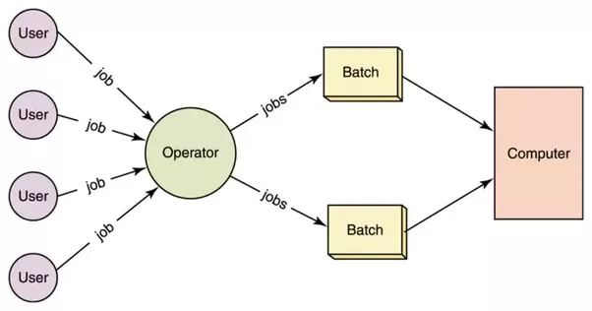
Batch Operating System
In batch operating system same type of processes are batched together for execution.
Eg: Bank Statements, Payroll System
Problem with Batch OS
1. Starvation
2. Not Interactive

Slide 13
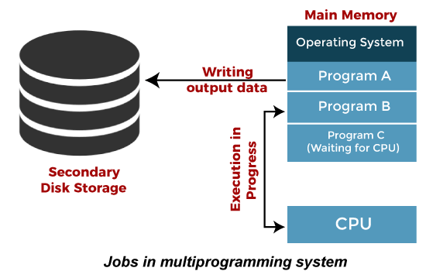
Multiprogramming Operating System
It is an extension to batch processing where the CPU is always kept busy.
Each process needs two types of system time: CPU time and IO time.
When a process does its I/O, The CPU can start the execution of other processes
Pipeline Execution
Non-preemptive
Improves the efficiency of the system.
Response time can also be reduced.

Slide 14
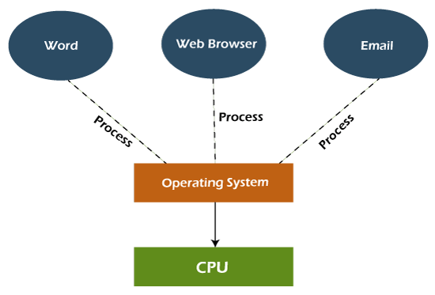
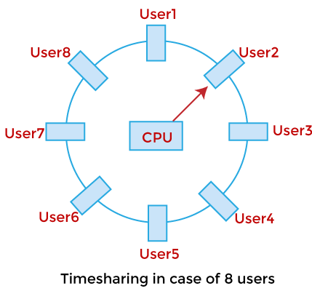
Multitasking Operating System
It is a logical extension of a multiprogramming system
Enables execution of multiple programs simultaneously.
Switching between the program
Preemptive
It allows a user to perform more than one
computer task at the same time.

Slide 15
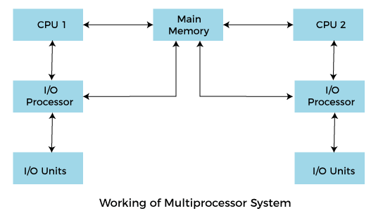
Multiprocessing Operating System
More than one processors present in the system.
Parallel computing is achieved.
Increased throughout
Increased reliability
Complex and sophisticated as it
takes care of multiple CPUs simultaneously.

Slide 16
Real Time Operating System
Each job carries a certain deadline within which the job is supposed to be completed.
If the result is produced, it will be completely useless.
Real-Time system exists in the case of military applications, if you want to drop a missile, then the missile is supposed to be dropped with a certain precision.
Real-time operating systems are very costly to develop.
Real-time operating systems are very complex and can consume critical CPU cycles.

Slide 17
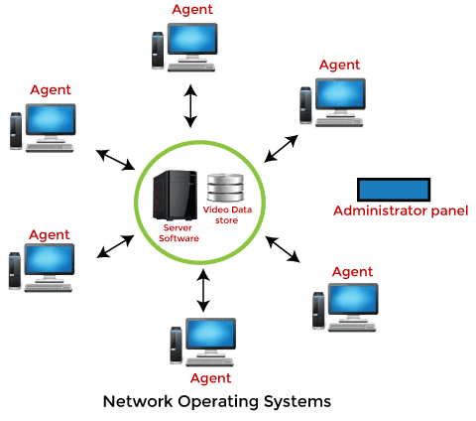
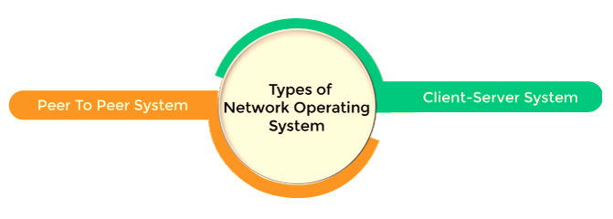
Network Operating System
It includes software and associated protocols to communicate with other computers via a network conveniently and cost-effectively.
Network traffic reduces due to the division
between clients and the server.

Slide 18
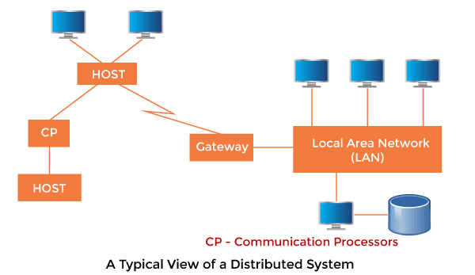
Distributed Operating System
Distributed Operating system is not installed on a single machine, it is divided into parts, and these parts are loaded on different machines.
Distributed Operating systems are much more complex, large, and sophisticated than Network operating systems.
The distributed operating system provides
sharing of resources.
This type of system is fault-tolerant.
Computation speed up – load sharing

Slide 19
Throughput of a system is
a) Number of programs processed by it per unit time
b) Number of times the program is invoked by the system
c) Number of requests made to a program by the system
d) None of the above
Logical extension of multiprogramming of operating system is
a) Time sharing
b) Distributed computing
c) Single programming
d)Batch processing
Which operating system implementation has to focus on the issue of Good response time
a) Batch Processing
b) Multiprogramming
c) Distributed
d) Time sharing
Which operating system implementation has to focus on the issue of resource sharing?
a) Batch Processing
b) Multiprogramming
c) Distributed
d) Time sharing

